Slide 1
Homework 1
Due: Sept 18th, Friday at 11:55pm
Midterm Exam 1
Sept 23, Next Wednesday

Slide 2
COMP 3500 Solving Synchronization Problems Part 1
Dr. Xiao Qin
Auburn University http://www.eng.auburn.edu/~xqin
xqin@auburn.edu
Notes:
Reference: semaphores.html

Slide 3
Sharing Two Variables
proc_A() {
while(TRUE) {
<compute section A1>;
update(x);
/* Signal proc_B */
V(s1);
<compute section A2>;
/* Wait for proc_B */
P(s2);
retrieve(y);
}
}
semaphore s1 = 0;
semaphore s2 = 0;
fork(proc_A, 0);
fork(proc_B, 0);
proc_B() {
while(TRUE) {
/* Wait for proc_A */
P(s1);
retrieve(x);
<compute section B1>;
update(y);
/* Signal proc_A */
V(s2);
<compute section B2>;
}
}
Semaphores: P=wait; V=signal
Critical Sections
Synchronizations

Slide 4
Device Controller Synchronization
The semaphore principle is logically used with the busy and done flags in a controller
Driver signals controller with a V(busy), then waits for completion with P(done)
Controller waits for work with P(busy), then announces completion with V(done)

Slide 5
Exercise 1: Semaphore as a General Synchronization Tool
Use semaphore flag initialized to 0
Code:
Proc_{i} Proc_{j}
 
B P(flag)
V(flag) A
What is the sequence of A and B?
P(S): S.value--;
if (S.value < 0) {
add this process to S.L; block;
}
V(S): S.value++;
if (S.value <= 0) {
remove a process P from S.L; wakeup(P);
}
Execute A in P_{j} only after B executed in P_{i}

Slide 6
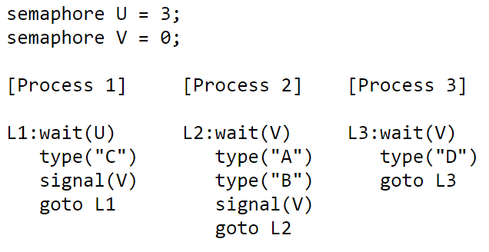
Exercise 2.1: Three interacting processes
Assuming execution is eventually halted, how many C's are printed when the set of processes runs?
Notes:
Within each process the statements are executed sequentially, but statements from different processes can be interleaved in any order that's consistent with the constraints imposed by the semaphores. When answering the questions below assume that once execution begins, the processes will be allowed to run until all 3 processes are stuck in a wait() statement, at which point execution is halted.
Exactly 3. Each time Process 1 executes the "wait(U)" statement, the value of semaphore U is decremented by 1. Since there are no "signal(U)" statements, the loop in Process 1 will execute only 3 times (ie, the initial value of U) and then stall the fourth time "wait(U)" is executed.

Slide 7
Exercise 2.2: Three interacting processes
Assuming execution is eventually halted, how many D's are printed when this set of processes runs?
Notes:
Exactly 3. Process 1 will execute its loop three times (see the answer to the previous question), incrementing "signal(V)" each time through the loop. This will permit "wait(V)" to complete three times. For every "wait(V)" Process 2 executes, it also executes a "signal(V)" so there is no net change in the value of semaphore V caused by Process 2. Process 3 does decrement the value of semaphore V, typing out "D" each time it does so. So Process 3 will eventually loop as many times as Process 1.

Slide 8
Exercise 2.3: Three interacting processes
What is the smallest number of A's that might be printed when this set of processes runs?
Notes:
0. If Process 3 is scheduled immediately after Process 1 executes "signal(V)", then Process 2 might continue being stalled at its "wait(V)" statement and hence never execute its "type" statements.

Slide 9
Exercise 2.4: Three interacting processes
Is CABABDDCABCABD a possible output sequence when this set of processes runs?
Notes:
No. Here are the events implied by the sequence above:start: U=3 V=0 type C: U=2 V=1 type A: U=2 V=0 type B: U=2 V=1 type A: U=2 V=0 type B: U=2 V=1 type D: U=2 V=0 type D: oops, impossible since V=0

Slide 10
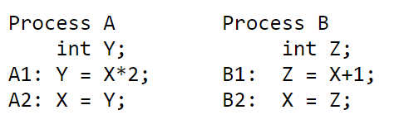
Exercise 3 Two processes share a common variable X:
X is set to 5 before either process begins execution. Statements within a process are executed sequentially.
How many different values of X are possible after both processes finish executing?
Notes:
There are four possible values for X. Here are the possible ways in which statements from A and B can be interleaved.
A1 A2 B1 B2: X = 11
A1 B1 A2 B2: X = 6
A1 B1 B2 A2: X = 10
B1 A1 B2 A2: X = 10
B1 A1 A2 B2: X = 6
B1 B2 A1 A2: X = 12
Use graphs
Y = X*2
|
V
X= Y -→ Z= X+1
|
V
X= Z
Z = X + 1
|
V
X= Z -→ Y= X*2
|
V
X= Y
Y = X*2
|
V
X= Y
Z = X + 1
|
V
X= Z

